Slide 1

Convective radiative plane Poiseuille flow of shear-thinning fluid through porous medium : An Application of Stefan Blowing
Under Supervision of
Dr. Pranab Kumar Mondal
Submitted By :
Chammandi Ravi Kiran (190103028)
Vikash Nirwan (190103121)

Slide 2
Introduction
We have studied the plane poiseuille flow of shear-thinning fluid (Carreau Model is considered) through a
porous medium.
Effects of heat transfer, magnetic field, thermal radiation and porosity are considered and derived analytical
solutions using Homotopy Analysis.
Carreau model has gained notable attention due to its significance in polymer extrusion, tumors treatment,
bitumen for road construction, etc.
The investigation of mixed convection in Poiseuille flow in a channel has gained unimaginable significance
because of its utilization in the geophysical framework, film vaporization in ignition chambers, rocket exhaust,
cooling arrangements in electronic gadgets, etc.
The fluid flow of various types involving the thermal transfer in a porous medium have been the center of
attraction for many scientists due to physical applications, which includes crude oil extraction, fiber insulation,
etc.

Slide 3
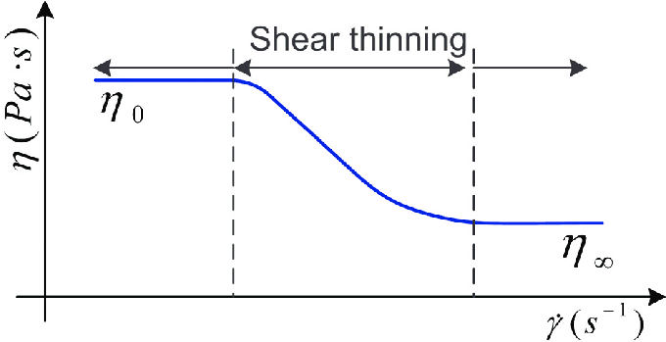
Shear Thinning Fluid
Shear thinning is a non-newtonian behaviour of fluids whose viscocity decreases with increase
in shear rate.
They are also known as Pseudo-plastics. Some of the examples are blood, liquid detergent
ketchup, paints, etc.
There are many models for Shear thinning fluids such as Power Law Model, Carreau Model,
Yasuda model ( a modified carreau model).
Power law model is the simplest model but it is not applicable at extremely high and low shear
rates. So to overcome this limitation, we are considering Carreau Model as they retain at
high and low shear rates.

Slide 4
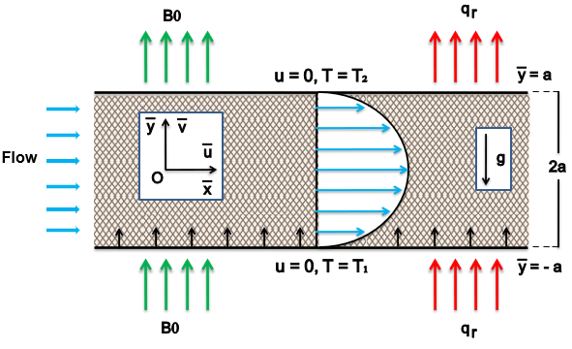
Problem Formulation
We consider time-independent 2D incompressible Carreau nanofluid fluid flowing through a porous medium with presence of Magnetic field, Thermal radiation and Stefan blowing effect. The geometry of porous medium channel and fluid region along with coordinate axes is depicted in Fig. 1. The fluid drives due to action of constant pressure gradient with buoyancy forces.
Fig. 1. Problem Configuration

Slide 5



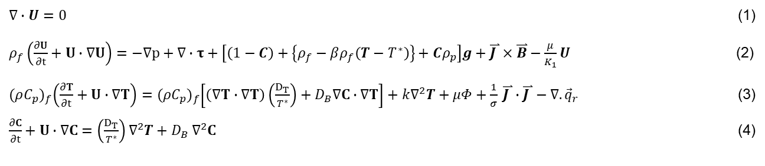
Governing equations
$∇∙U=0$ (1)
$ρ_{f}\left(\frac{∂U}{∂t}+U∙∇U\right)=−∇p+∇∙τ+\left[\left(1−C\right)+\left\{ρ_{f}−βρ_{f}\left(T−T^{∗}\right)\right\}+Cρ_{p}\right]g+\overset{⃑}{J }×\overset{⃑}{B}−\frac{μ}{K_{1}}U$ (2)
${(ρC_{p})}_{f}\left(\frac{∂T}{∂t}+U∙∇T\right)={(ρC_{p})}_{f}\left[\left(∇T∙∇T\right)\left(\frac{D_{T}}{T^{∗}}\right)+D_{B}∇C∙∇T\right]+k∇^{2}T+μΦ+\frac{1}{σ} \overset{⃑}{J }∙\overset{⃑}{J }−∇.{\vec{q}}_{r}$ (3)
$\frac{∂C}{∂t}+U∙∇C=\left(\frac{D_{T}}{T^{∗}}\right)∇^{2}T+D_{B} ∇^{2}C$ (4)
For Carreau Model,
For the case , apparent viscocity becomes,
⇒

Slide 6




Viscous dissipation is given by,
Radiative heat flux is given by,
After expanding the governing equations (1)-(4) we get,
$\frac{∂u}{∂x}+ \frac{∂v}{∂y}=0$ (5)
$ρ_{f}\left(u\frac{∂u}{∂x}+ v\frac{∂v}{∂y}\right)=−\frac{∂p}{∂x}+μ\left[1+\frac{3\left(n−1\right)}{2}{\left(λ\frac{∂u}{∂y}\right)}^{2}\right]\frac{∂^{2}u}{∂y^{2}}−σ_{f}B_{0}^{2}u−\frac{μ}{K_{1}}u$
$+\left[\left(1−C^{∗}\right)\left(T−T^{∗}\right)ρ_{f}β−(C−C^{∗})(ρ_{p}−ρ_{f})\right]g$ (6)
$${\left(ρC_{p}\right)}_{f}\left(u\frac{∂T}{∂x}+ v\frac{∂T}{∂y}\right)=k\frac{∂^{2}T}{∂y^{2}}+τ {\left(ρC_{p}\right)}_{f}\left(\frac{D_{T}}{T^{∗}}{\left(\frac{∂T}{∂y}\right)}^{2}+D_{B}\frac{∂C}{∂y}\frac{∂T}{∂y}\right)+μ{\left(\frac{∂u}{∂y}\right)}^{2}+σ_{f}B_{0}^{2}u$$
$+\frac{16σ^{∗}{T^{∗}}^{3}}{3k^{∗}}\frac{∂^{2}T}{∂y^{2}}$ (7)
$u\frac{∂C}{∂x}+v\frac{∂C}{∂y}=\frac{D_{T}}{T^{∗}}\left(\frac{∂^{2}T}{∂y^{2}}\right)+D_{B}\left(\frac{∂^{2}C}{∂y^{2}}\right)$ (8)

Slide 7
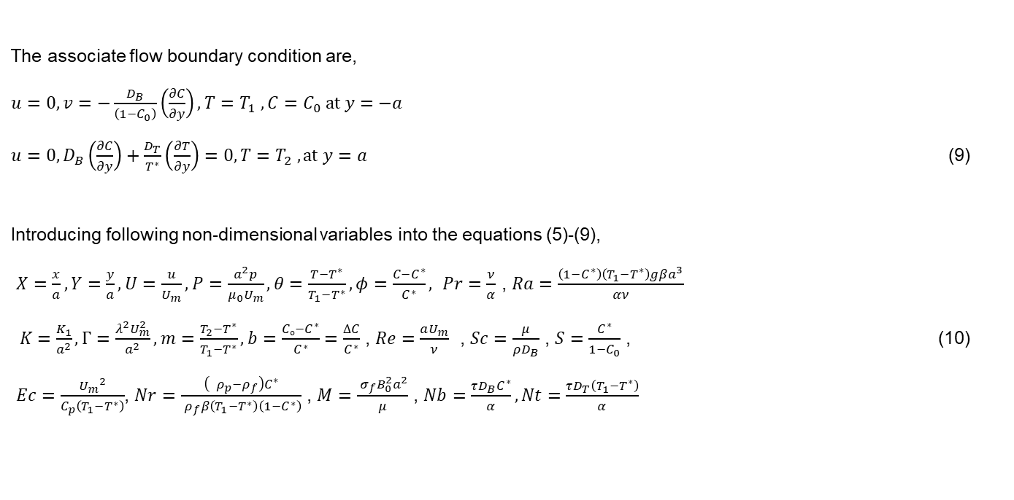
The associate flow boundary condition are,
$u=0, v=−\frac{D_{B}}{\left(1−C_{0}\right)}\left(\frac{∂C}{∂y}\right), T=T_{1} , C=C_{0} at y=−a$
$u=0,D_{B}\left(\frac{∂C}{∂y}\right)+\frac{D_{T}}{T^{∗}}\left(\frac{∂T}{∂y}\right)=0, T=T_{2} , at y=a$ (9)
Introducing following non-dimensional variables into the equations (5)-(9),
$X=\frac{x}{a}, Y=\frac{y}{a}, U=\frac{u}{U_{m}}, P=\frac{a^{2}p}{μ_{0}U_{m}}, θ=\frac{T−T^{∗}}{T_{1}−T^{∗}}, φ=\frac{C−C^{∗}}{C^{∗}},$ $Pr=\frac{ν}{α}$ , $Ra=\frac{\left(1−C^{∗}\right)\left(T_{1}−T^{∗}\right)gβa^{3}}{αν}$
$K=\frac{K_{1}}{a^{2}}, Γ=\frac{λ^{2}U_{m}^{2}}{a^{2}}, m=\frac{T_{2}−T^{∗}}{T_{1}−T^{∗}}, b=\frac{Cₒ−C^{∗}}{C^{∗}}=\frac{∆C}{C^{∗}}$ , $Re=\frac{aU_{m}}{ν}$ , $Sc=\frac{μ}{ρD_{B}}$ , $S=\frac{C^{∗}}{1−C_{0}}$ , (10)
$Ec=\frac{{U_{m}}^{2}}{C_{p}\left(T_{1}−T^{∗}\right)}$, $Nr=\frac{\left({ { ρ}_{p}−ρ}_{f}\right)C^{∗}}{{ ρ}_{f}β\left(T_{1}−T^{∗}\right)\left(1−C^{∗}\right)}$ , $M=\frac{{ σ}_{f}B_{0}^{2}a^{2}}{μ}$ , $Nb=\frac{τD_{B}C^{∗}}{α},Nt=\frac{τD_{T}\left(T_{1}−T^{∗}\right)}{α}$

Slide 8
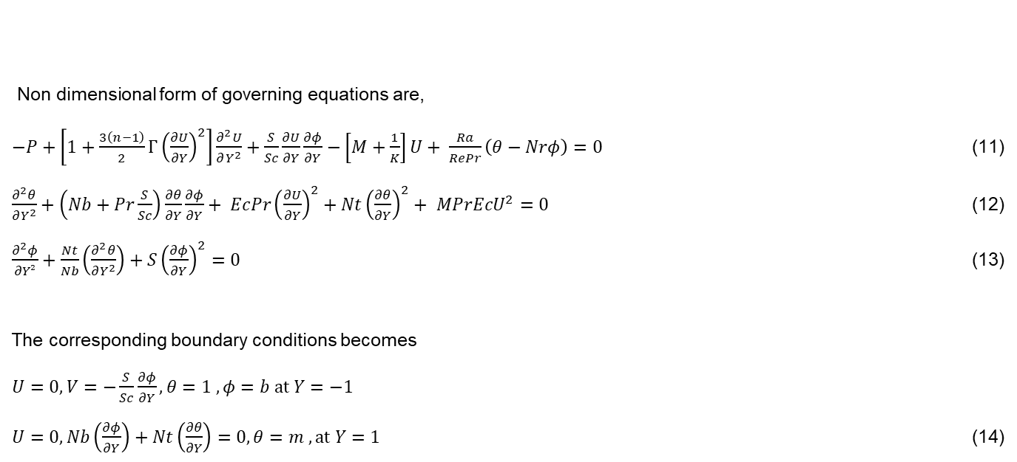
Non dimensional form of governing equations are,
$−P+\left[1+\frac{3\left(n−1\right)}{2}{Γ\left(\frac{∂U}{∂Y}\right)}^{2}\right]\frac{∂^{2}U}{∂Y^{2}}+\frac{S}{Sc}\frac{∂U}{∂Y}\frac{∂φ}{∂Y}−\left[M+\frac{1}{K}\right]U+ \frac{Ra}{RePr}\left(θ−Nrφ\right)=0$ (11)
$\frac{∂^{2}θ}{∂Y^{2}}+\left(Nb+Pr\frac{S}{Sc}\right)\frac{∂θ}{∂Y}\frac{∂φ}{∂Y}+ EcPr{\left(\frac{∂U}{∂Y}\right)}^{2}+Nt{\left(\frac{∂θ}{∂Y}\right)}^{2}+ MPrEcU^{2}=0$ (12)
$\frac{∂^{2}φ}{∂Y²}+\frac{Nt}{Nb}\left(\frac{∂^{2}θ}{∂Y^{2}}\right)+S{\left(\frac{∂φ}{∂Y}\right)}^{2}=0$ (13)
The corresponding boundary conditions becomes
$U=0, V=−\frac{S}{Sc}\frac{∂φ}{∂Y}, θ=1 , φ=b at Y=−1$
$U=0,Nb\left(\frac{∂φ}{∂Y}\right)+Nt\left(\frac{∂θ}{∂Y}\right)=0, θ=m , at Y=1$ (14)

Slide 9
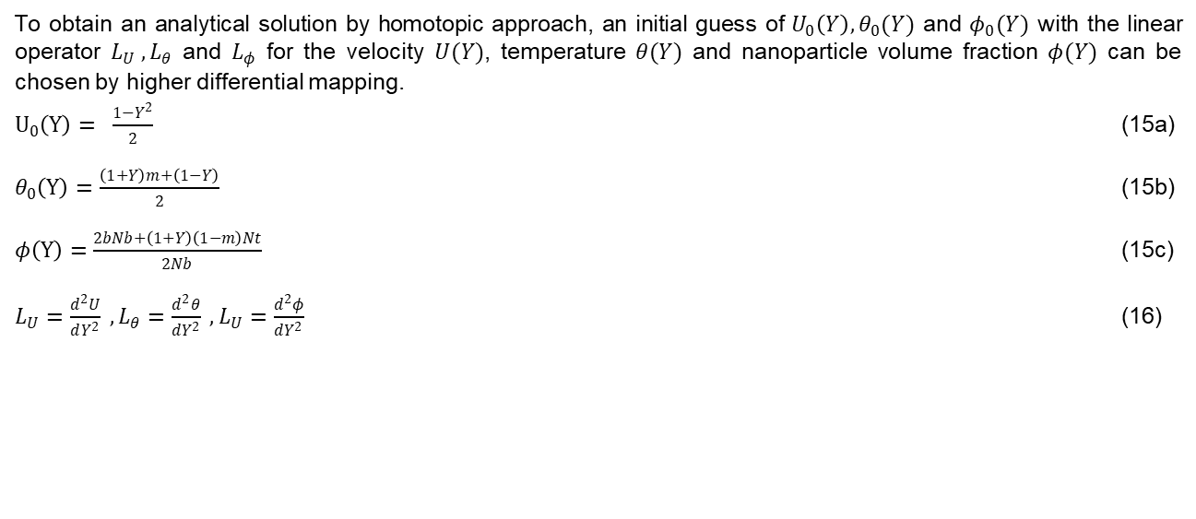
Approximate Analytical Solution
To obtain an analytical solution by homotopic approach, an initial guess of $U_{0}\left(Y\right), θ_{0}(Y)$ and $φ_{0}(Y)$ with the linear operator $L_{U} , L_{θ}$ and $L_{φ}$ for the velocity $U(Y)$, temperature $θ(Y)$ and nanoparticle volume fraction $φ(Y)$ can be chosen by higher differential mapping.
$U_{0}\left(Y\right)= \frac{1−Y^{2}}{2}$ (15a)
$θ_{0}\left(Y\right)=\frac{\left(1+Y\right)m+\left(1−Y\right)}{2}$ (15b)
$φ\left(Y\right)=\frac{2bNb+\left(1+Y\right)\left(1−m\right)Nt}{2Nb}$ (15c)
$L_{U}=\frac{d^{2}U}{dY^{2}} , L_{θ}=\frac{d^{2}θ}{dY^{2}} , L_{U}=\frac{d^{2}φ}{dY^{2}}$ (16)

Slide 10
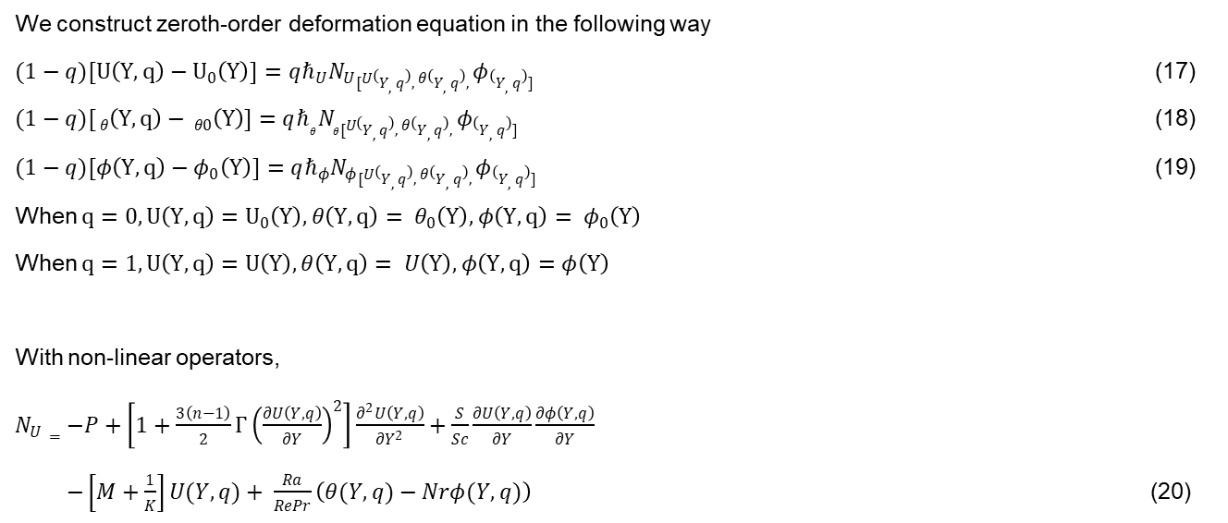
We construct zeroth-order deformation equation in the following way
$(1−q){[U\left(Y, q\right)−U}_{0}\left(Y\right)]=qℏ_{U}N_{U}[U\left(Y, q\right), θ\left(Y, q\right), φ\left(Y, q\right)]$ (17)
$(1−q){[ θ\left(Y, q\right)− θ}_{0}\left(Y\right)]=qℏ_{θ}N_{θ}[U\left(Y, q\right), θ\left(Y, q\right), φ\left(Y, q\right)]$ (18)
$(1−q){[φ\left(Y, q\right)−φ}_{0}\left(Y\right)]=qℏ_{φ}N_{φ}[U\left(Y, q\right), θ\left(Y, q\right), φ\left(Y, q\right)]$ (19)
When $q=0, U\left(Y, q\right)=U_{0}\left(Y\right), θ\left(Y,q\right)= θ_{0}\left(Y\right), φ\left(Y,q\right)= φ_{0}\left(Y\right)$
When $q=1, U\left(Y, q\right)=U\left(Y\right), θ\left(Y,q\right)= U\left(Y\right), φ\left(Y,q\right)=φ\left(Y\right)$
With non-linear operators,
$N_{U}=−P+\left[1+\frac{3\left(n−1\right)}{2}{Γ\left(\frac{∂U\left(Y, q\right)}{∂Y}\right)}^{2}\right]\frac{∂^{2}U\left(Y, q\right)}{∂Y^{2}}+\frac{S}{Sc}\frac{∂U\left(Y, q\right)}{∂Y}\frac{∂φ\left(Y, q\right)}{∂Y}$
$−\left[M+\frac{1}{K}\right]U(Y, q)+ \frac{Ra}{RePr}\left(θ(Y, q)−Nrφ(Y,q)\right)$ (20)

Slide 11
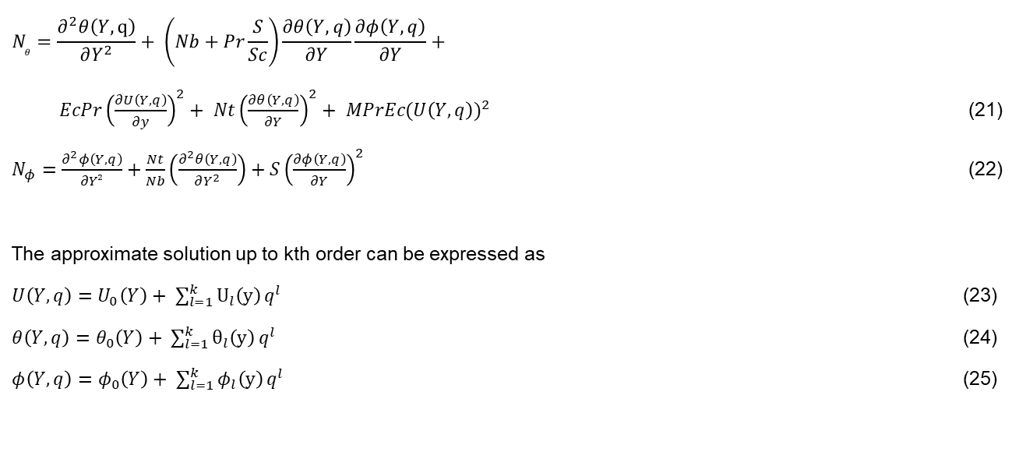
$$N_{θ}=\frac{∂^{2}θ\left(Y,q\right)}{∂Y^{2}}+ \left(Nb+Pr\frac{S}{Sc}\right)\frac{∂θ\left(Y, q\right)}{∂Y}\frac{∂φ\left(Y, q\right)}{∂Y}+$$
$EcPr{\left(\frac{∂U\left(Y, q\right)}{∂y}\right)}^{2}+ Nt{\left(\frac{∂θ\left(Y, q\right)}{∂Y}\right)}^{2}+ MPrEc({U\left(Y, q\right))}^{2}$ (21)
$N_{φ}=\frac{∂^{2}φ\left(Y, q\right)}{∂Y²}+\frac{Nt}{Nb}\left(\frac{∂^{2}θ\left(Y, q\right)}{∂Y^{2}}\right)+S{\left(\frac{∂φ\left(Y, q\right)}{∂Y}\right)}^{2}$ (22)
The approximate solution up to kth order can be expressed as
$U\left(Y, q\right)=U_{0}\left(Y\right)+ \sum_{l=1}^{k}{U_{l}\left(y\right)}q^{l}$ (23)
$θ\left(Y, q\right)=θ_{0}\left(Y\right)+ \sum_{l=1}^{k}{θ_{l}\left(y\right)}q^{l}$ (24)
$φ\left(Y, q\right)=φ_{0}\left(Y\right)+ \sum_{l=1}^{k}{φ_{l}\left(y\right)}q^{l}$ (25)

Slide 12
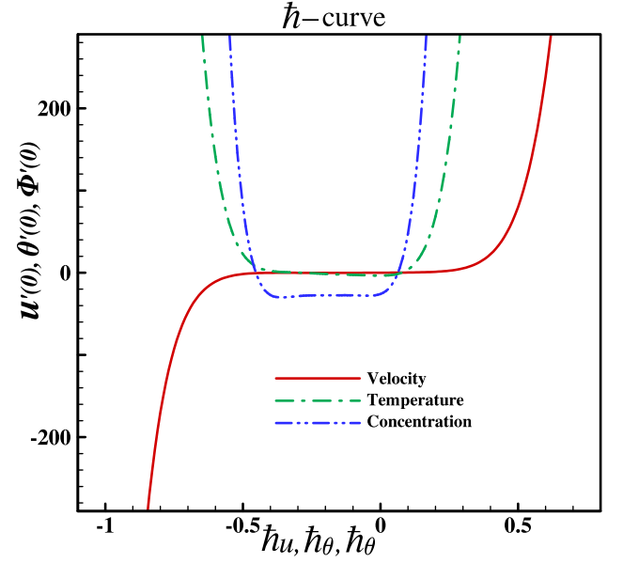
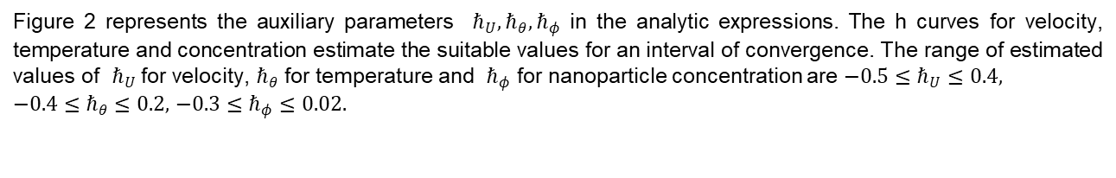
Results
Figure 2 represents the auxiliary parameters $ℏ_{U}, ℏ_{θ}, ℏ_{φ}$ in the analytic expressions. The h curves for velocity, temperature and concentration estimate the suitable values for an interval of convergence. The range of estimated values of $ℏ_{U}$for velocity, $ℏ_{θ}$ for temperature and $ℏ_{φ}$ for nanoparticle concentration are $−0.5≤ℏ_{U}≤0.4,$
$−0.4≤ℏ_{θ}≤0.2,$ $−0.3≤ℏ_{φ}≤0.02.$
Fig. 2. h curves

Slide 13
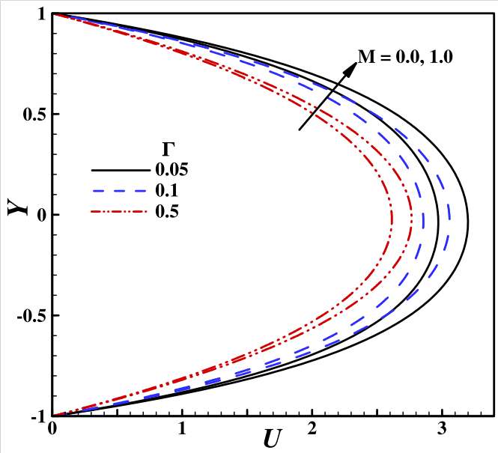
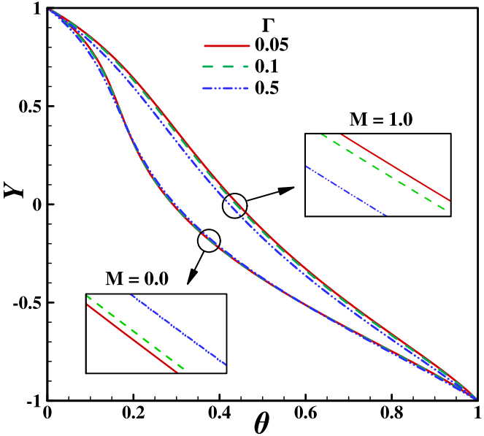
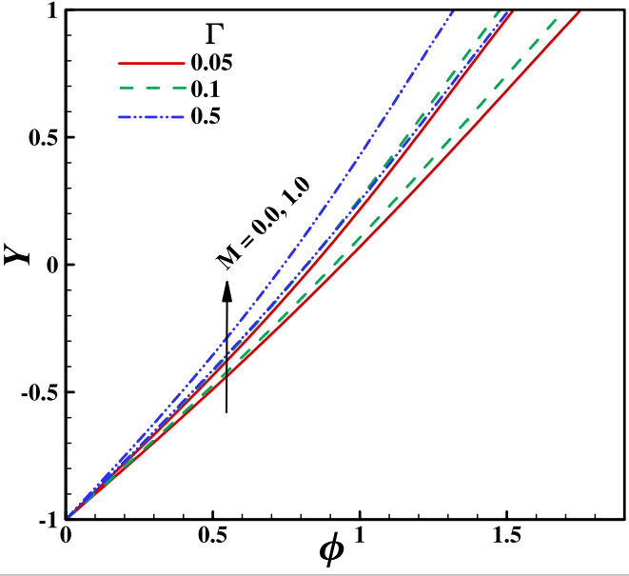
Figure 3.1, 3.2, 3.3 shows the effect of carreau parameter on velocity, temperature and concentration respectively with and without considering magnetic field.
Fig. 3.1. Effect of Carreau
parameter on Velocity
Fig. 3.2. Effect of Carreau
parameter on Temperature
Fig. 3.3. Effect of Carreau
parameter on Concentration

Slide 14
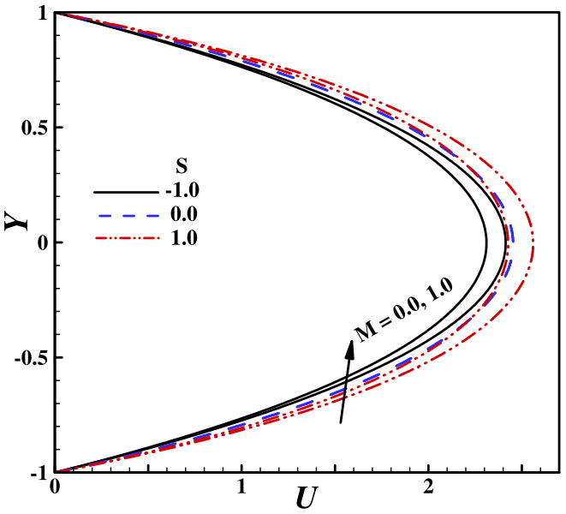
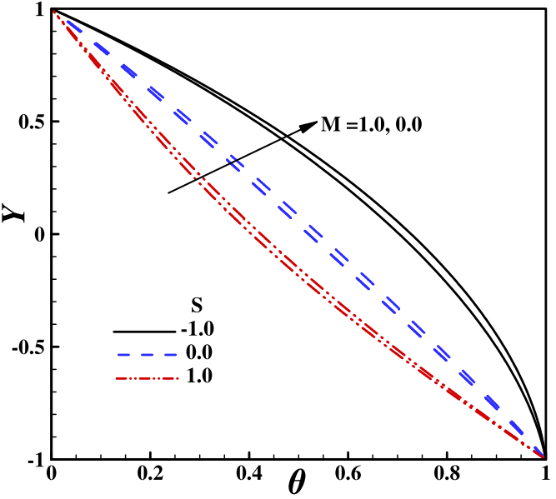
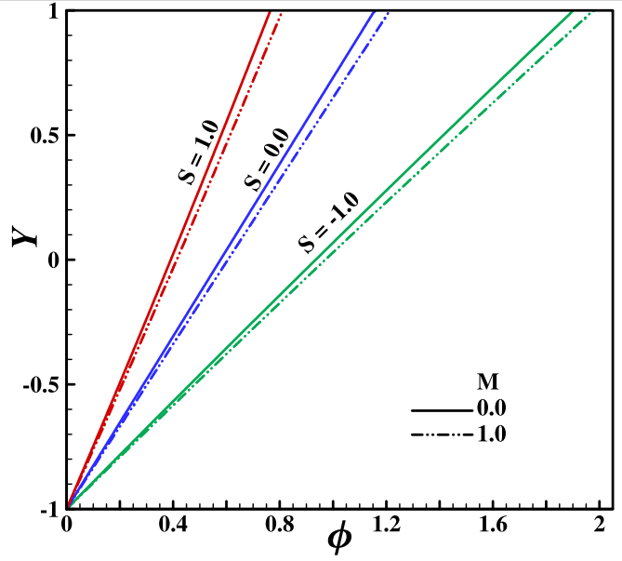
Figure 4.1, 4.2, 4.3 shows the effect of Stefan blowing parameter on velocity, temperature and concentration respectively with and without presence of magnetic field.
Fig. 4.1. Effect of Stefan blowing
parameter on Velocity
Fig. 4.2. Effect of Stefan blowing
parameter on Temperature
Fig. 4.3. Effect of Stefan blowing
parameter on Concentration

Slide 15
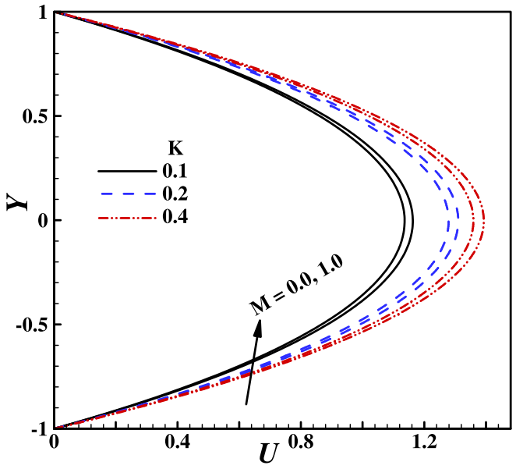
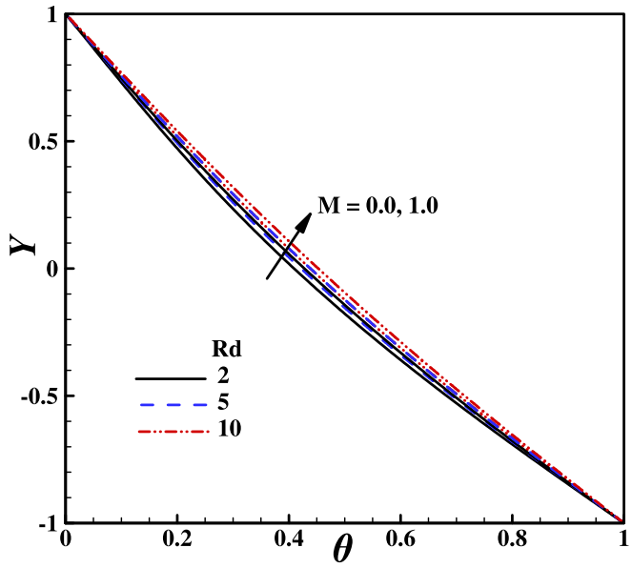
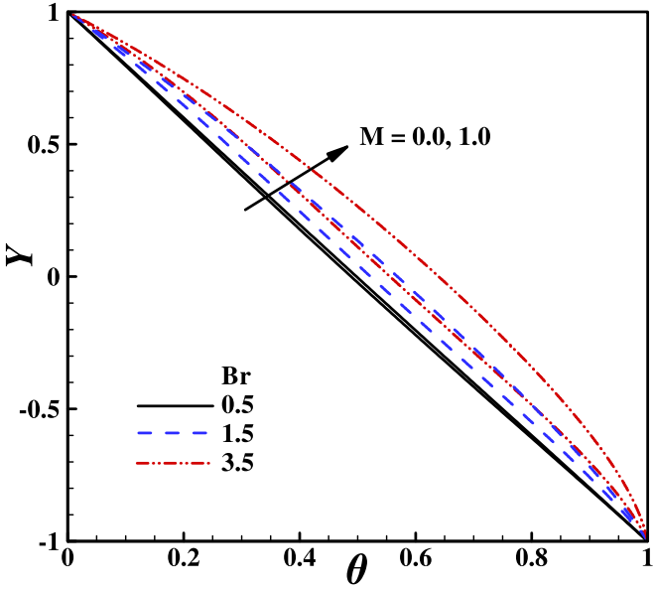
Figure 5 shows the effect of porosity on velocity. Figure 6 shows the effect of thermal radiation parameter on temperature. Figure 7 shows the effect of brinkman number on temperature.
Fig. 5. Effect of porosity
parameter on Velocity
Fig. 6. Effect of thermal radiation
parameter on Temperature
Fig. 7. Effect of Brinkman number
on Temperature

Slide 16
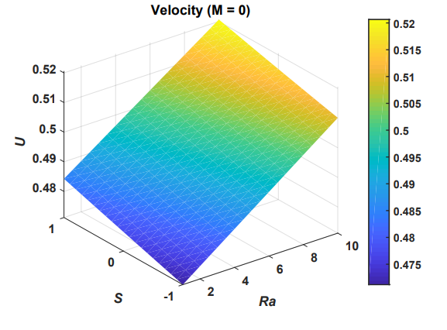
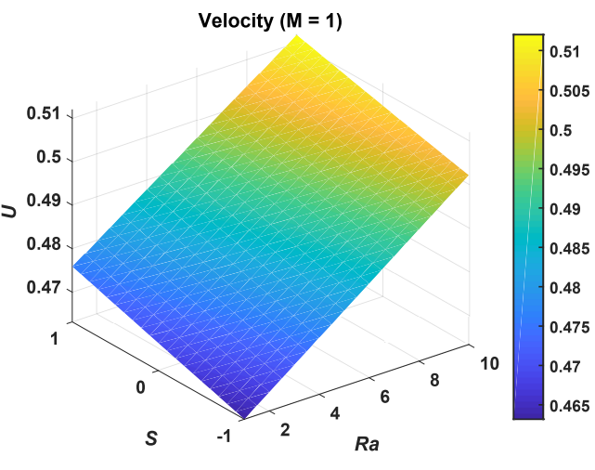
Figure 8, 9 depicts the 3D plots of velocity with and without the presence of magnetic field respectively.
Fig. 8. Surface Plot of Velocity in absence
of magnetic field
Fig. 9. Surface Plot of Velocity in presence
of magnetic field

Slide 17
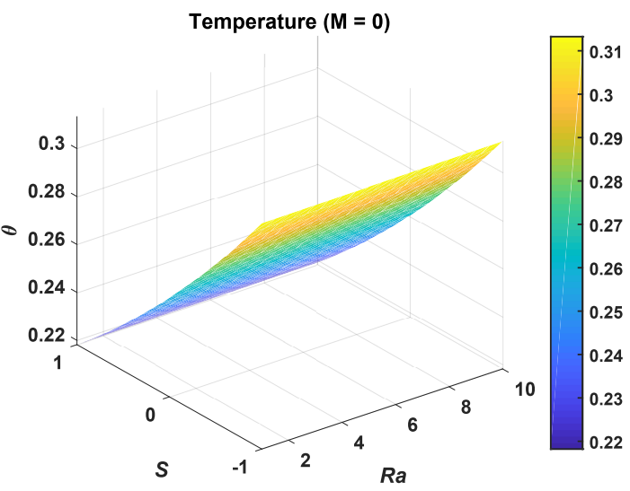
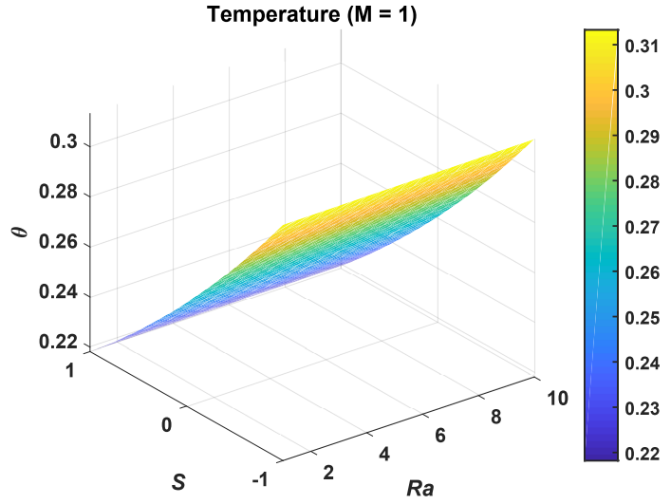
Figure 10, 11 depicts 3D plots of temperature with and without the presence of magnetic field respectively.
Fig. 10. Surface Plot of Temperature in absence of magnetic field
Fig. 11. Surface Plot of Temperature in presence
of magnetic field

Slide 18
Conclusions
An approximate analytical investigation of plane Poiseuille shear thinning fluid flow between two parallel horizontal walls via homotopic analysis. The walls are contained at different temperatures with no slip. The effects of various parameters are analyzed in graphical forms. The main findings are summarized as follows:
With the increase in carreau parameter, velocity decreases with and without presence of magnetic field.
With increase in carreau parameter, temperature decreases in the presence of magnetic field whereas temperature increases when magnetic field is not applied.
With the increase in carreau parameter, concentration decreases with and without presence of magnetic field.
With increase in porosity, velocity increases with and without the presence of magnetic field.
With the increase in thermal radiation parameter, temperature increases with and without the presence of magnetic field.
With the increase in brinkman number temperature increases with and without the presence of magnetic field.

Slide 19
Analytical Solution for Heat Transfer in Electroosmotic Flow of a Powell Eyring Fluid in a Wavy Microchannel
Under Supervision of
Dr. Pranab Kumar Mondal
Submitted By :
Chammandi Ravi Kiran (190103028)
Vikash Nirwan (190103121)

Slide 20
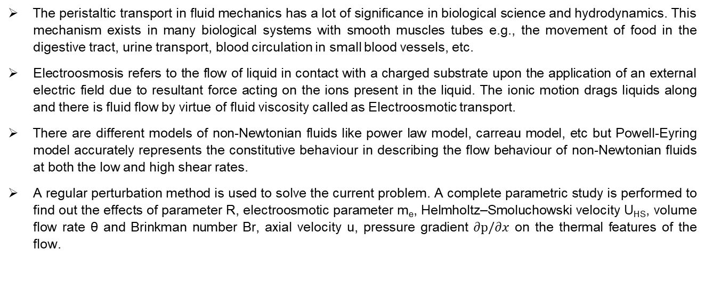
Introduction
The peristaltic transport in fluid mechanics has a lot of significance in biological science and hydrodynamics. This mechanism exists in many biological systems with smooth muscles tubes e.g., the movement of food in the digestive tract, urine transport, blood circulation in small blood vessels, etc.
Electroosmosis refers to the flow of liquid in contact with a charged substrate upon the application of an external electric field due to resultant force acting on the ions present in the liquid. The ionic motion drags liquids along and there is fluid flow by virtue of fluid viscosity called as Electroosmotic transport.
There are different models of non-Newtonian fluids like power law model, carreau model, etc but Powell-Eyring model accurately represents the constitutive behaviour in describing the flow behaviour of non-Newtonian fluids at both the low and high shear rates.
A regular perturbation method is used to solve the current problem. A complete parametric study is performed to find out the effects of parameter R, electroosmotic parameter m_{e}, Helmholtz–Smoluchowski velocity U_{HS}, volume flow rate θ and Brinkman number Br, axial velocity u, pressure gradient $∂p/∂x$ on the thermal features of the flow.

Slide 21
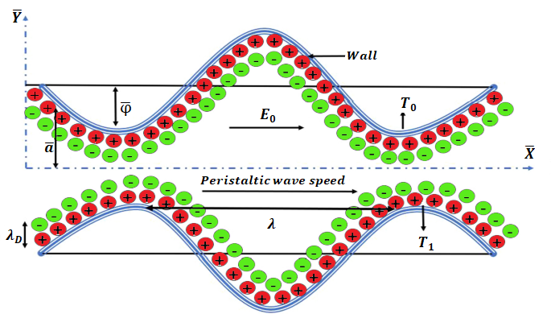
Problem Formulation
Consider a two-dimensional peristaltic flow $\left(\overline{X},\overline{Y}\right)$ of an incompressible Powell Eyring fluid through a way micro-channel as shown in Fig. 1.
Fig. 1. Problem Configuration

Slide 22

Governing equations
The governing equations for mass, momentum and energy in laboratory frame are:
Continuity equation:
$\frac{∂\overline{U}}{∂\overline{X}}+\frac{∂\overline{V}}{∂\overline{Y}}=0$ (1)
Momentum equation in x-direction:
$ρ\left(\frac{∂\overline{U}}{∂\overline{t}}+\overline{U}\frac{∂\overline{U}}{∂\overline{X}}+\overline{V}\frac{∂\overline{U}}{∂\overline{Y}}\right)=−\frac{∂\overline{P}}{∂\overline{X}}+\left(\frac{∂{\overline{τ}}_{\overline{X}\overline{X}}}{∂\overline{X}}+\frac{∂{\overline{τ}}_{\overline{X}\overline{Y}}}{∂\overline{Y}}\right)+ρ_{e}E_{0}$ (2)
Momentum equation in y-direction:
$ρ\left(\frac{∂\overline{V}}{∂\overline{t}}+\overline{U}\frac{∂\overline{V}}{∂\overline{X}}+\overline{V}\frac{∂\overline{V}}{∂\overline{Y}}\right)=−\frac{∂\overline{P}}{∂\overline{X}}+\left(\frac{∂{\overline{τ}}_{\overline{Y}\overline{X}}}{∂\overline{X}}+\frac{∂{\overline{τ}}_{\overline{Y}\overline{Y}}}{∂\overline{Y}}\right)$ (3)

Slide 23
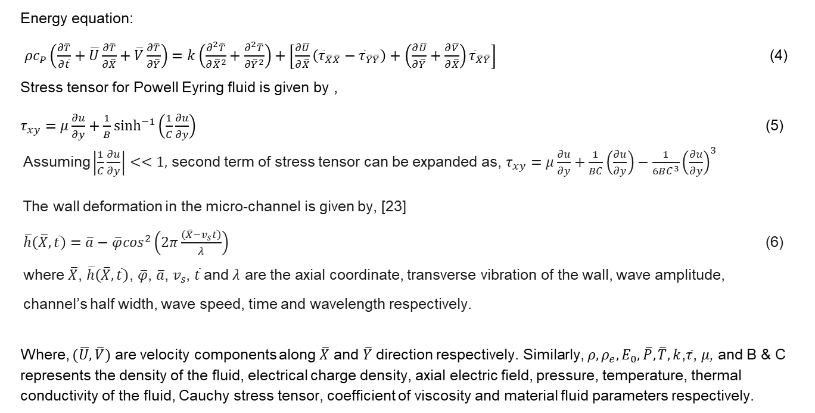
Energy equation:
$ρc_{P}\left(\frac{∂\overline{T}}{∂\overline{t}}+\overline{U}\frac{∂\overline{T}}{∂\overline{X}}+\overline{V}\frac{∂\overline{T}}{∂\overline{Y}}\right)=k\left(\frac{∂^{2}\overline{T}}{∂{\overline{X}}^{2}}+\frac{∂^{2}\overline{T}}{∂{\overline{Y}}^{2}}\right)+\left[\frac{∂\overline{U}}{∂\overline{X}}\left({\overline{τ}}_{\overline{X}\overline{X}}−{\overline{τ}}_{\overline{Y}\overline{Y}}\right)+\left(\frac{∂\overline{U}}{∂\overline{Y}}+\frac{∂\overline{V}}{∂\overline{X}}\right){\overline{τ}}_{\overline{X}\overline{Y}}\right]$ (4)
Stress tensor for Powell Eyring fluid is given by ,
$τ_{xy}=μ\frac{∂u}{∂y}+\frac{1}{B}\sinh^{−1}\left(\frac{1}{C}\frac{∂u}{∂y}\right)$ (5)
Assuming $\left|\frac{1}{C}\frac{∂u}{∂y}\right|<<1,$ second term of stress tensor can be expanded as, $τ_{xy}=μ\frac{∂u}{∂y}+\frac{1}{BC}\left(\frac{∂u}{∂y}\right)−\frac{1}{6BC^{3}}{\left(\frac{∂u}{∂y}\right)}^{3}$
The wall deformation in the micro-channel is given by, [23]
$\overline{h}\left(\overline{X},\overline{t}\right)=\overline{a}−\overline{φ}\cos^{2}\left(2π\frac{\left(\overline{X}−v_{s}\overline{t}\right)}{λ}\right)$ (6)
where $\overline{X}$, $\overline{h}\left(\overline{X},\overline{t}\right)$, $\overline{φ}$, $\overline{a}$, $v_{s}$, $\overline{t}$and $λ$ are the axial coordinate, transverse vibration of the wall, wave amplitude,
channel’s half width, wave speed, time and wavelength respectively.
Where, $(\overline{U},\overline{V})$ are velocity components along $\overline{X} \text{and} \overline{Y}$ direction respectively. Similarly, $ρ,ρ_{e},E_{0},\overline{P},\overline{T},k$,$\overline{τ}$, $μ$, and B & C represents the density of the fluid, electrical charge density, axial electric field, pressure, temperature, thermal conductivity of the fluid, Cauchy stress tensor, coefficient of viscosity and material fluid parameters respectively.

Slide 24
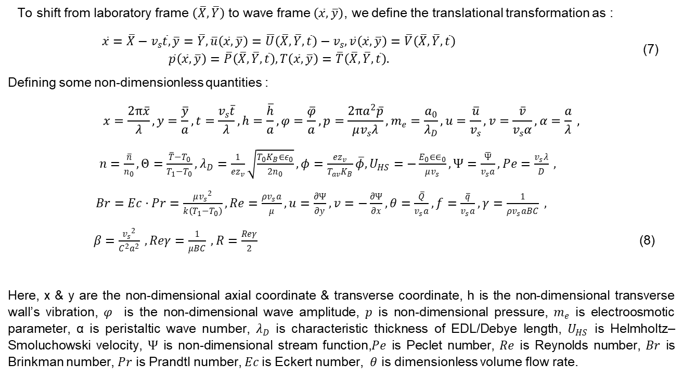
To shift from laboratory frame $\left(\overline{X},\overline{Y}\right)$ to wave frame $\left(\overline{x},\overline{y}\right)$, we define the translational transformation as :
$\begin{aligned}\overline{x}=\overline{X}−v_{s}\overline{t},\overline{y}=\overline{Y},\overline{u}\left(\overline{x},\overline{y}\right)=\overline{U}\left(\overline{X},\overline{Y},\overline{t}\right)−v_{s},\overline{v}\left(\overline{x},\overline{y}\right)=\overline{V}\left(\overline{X},\overline{Y},\overline{t}\right) \\ \overline{p}\left(\overline{x},\overline{y}\right)=\overline{P}\left(\overline{X},\overline{Y},\overline{t}\right),T\left(\overline{x},\overline{y}\right)=\overline{T}\left(\overline{X},\overline{Y},\overline{t}\right).\end{aligned}$ (7)
Defining some non-dimensionless quantities :
$$x=\frac{2π\overline{x}}{λ},y=\frac{\overline{y}}{a},t=\frac{v_{s}\overline{t}}{λ},h=\frac{\overline{h}}{a},φ=\frac{\overline{φ}}{a},p=\frac{2πa^{2}\overline{p}}{μv_{s}λ},m_{e}=\frac{a_{0}}{λ_{D}},u=\frac{\overline{u}}{v_{s}},v=\frac{\overline{v}}{v_{s}α},α=\frac{a}{λ} ,$$
$n=\frac{\overline{n}}{n_{0}},Θ=\frac{\overline{T}−T_{0}}{T_{1}−T_{0}},λ_{D}=\frac{1}{ez_{v}}\sqrt{\frac{T_{0}K_{B}∈ε_{0}}{2n_{0}}},φ=\frac{ez_{v}}{T_{av}K_{B}}\overline{φ},U_{HS}=−\frac{E_{0}∈∈_{0}}{μv_{s}},Ψ=\frac{\overline{Ψ}}{v_{s}a},Pe=\frac{v_{s}λ}{D} ,$
$Br=Ec⋅Pr=\frac{{μv_{s}}^{2}}{k\left(T_{1}−T_{0}\right)},Re=\frac{ρv_{s}a}{μ}, u=\frac{∂Ψ}{∂y},v=−\frac{∂Ψ}{∂x},θ=\frac{\overline{Q}}{v_{s}a},f=\frac{\overline{q}}{v_{s}a},γ=\frac{1}{ρv_{s}aBC} ,$
$β=\frac{{v_{s}}^{2}}{C^{2}a^{2}} , Reγ=\frac{1}{μBC} , R=\frac{Reγ}{2}$ (8)
Here, x & y are the non-dimensional axial coordinate & transverse coordinate, h is the non-dimensional transverse wall’s vibration, $φ$ is the non-dimensional wave amplitude, $p$ is non-dimensional pressure, $m_{e}$ is electroosmotic parameter, α is peristaltic wave number, $λ_{D}$ is characteristic thickness of EDL/Debye length, $U_{HS}$ is Helmholtz–Smoluchowski velocity, $Ψ$ is non-dimensional stream function,$Pe$ is Peclet number, $Re$ is Reynolds number, $Br$ is Brinkman number, $Pr$ is Prandtl number, $Ec$is Eckert number, $θ$ is dimensionless volume flow rate.

Slide 25
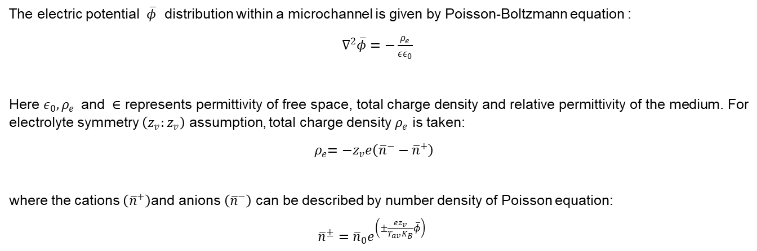
The electric potential $\overline{φ}$ distribution within a microchannel is given by Poisson-Boltzmann equation :
$∇^{2}\overline{φ}=−\frac{ρ_{e}}{εε_{0}}$
Here $ε_{0}{,ρ}_{e} \text{and} ∈$ represents permittivity of free space, total charge density and relative permittivity of the medium. For electrolyte symmetry $\left(z_{v}:z_{v}\right)$ assumption, total charge density $ρ_{e}$ is taken:
${ ρ}_{e}=−z_{v}e\left({\overline{n}}^{−}−{\overline{n}}^{+}\right)$
where the cations $\left({\overline{n}}^{+}\right)\text{and} \text{anions} \left({\overline{n}}^{−}\right)$ can be described by number density of Poisson equation:
${\overline{n}}^{±}={\overline{n}}_{0}e^{\left(±\frac{ez_{v}}{T_{av}K_{B}}\overline{φ}\right)}$

Slide 26

The non-dimensional equations are,
$\frac{d^{2}φ}{dy^{2}}=−m_{e}^{2}\left(\frac{n^{+}−n^{−}}{2}\right)$
${ n}^{±}=e^{∓φ}$
Using Debye-Hückel linearization approximation i.e., sinh$ϕ$ ≈ $ϕ$, the above equation becomes,
$\frac{d^{2}φ}{ dy^{2}}=m_{e}^{2}φ$
Whereas the analytical solution of electrical potential $φ$ is given by,
$$φ=\frac{\cosh\left(m_{e}y\right)}{\cosh\left(m_{e}h\right)}$$

Slide 27
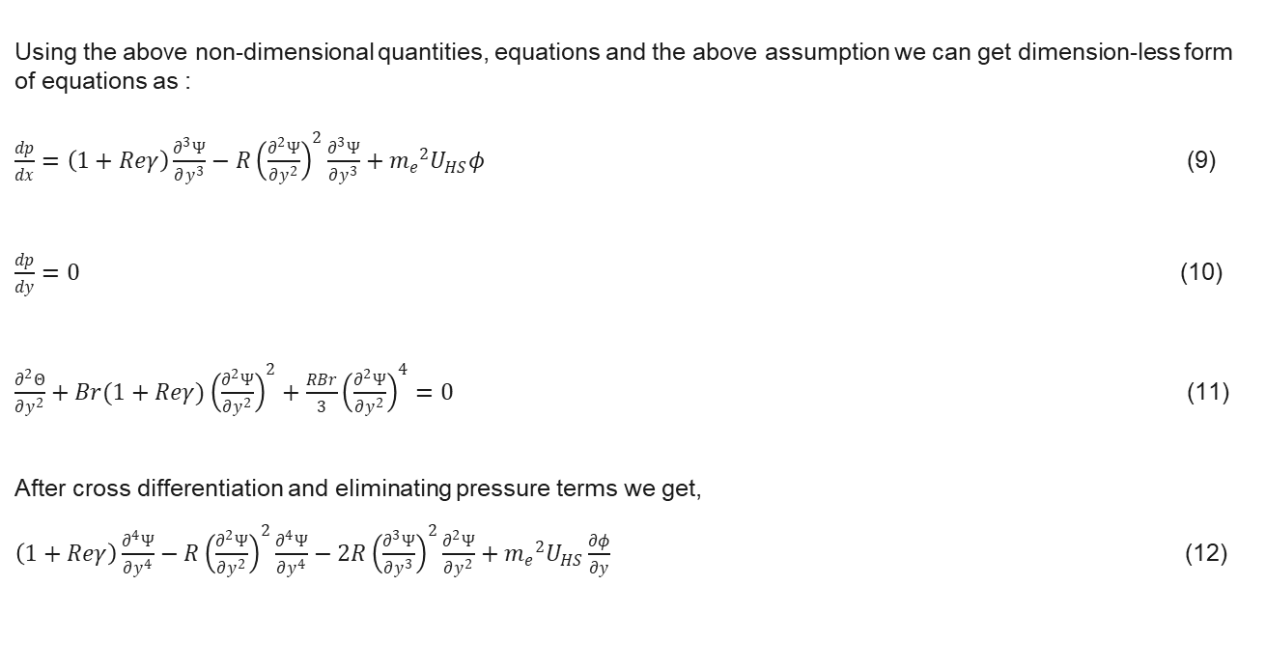
Using the above non-dimensional quantities, equations and the above assumption we can get dimension-less form of equations as :
$\frac{dp}{dx}=\left(1+Reγ\right)\frac{∂^{3}Ψ}{∂y^{3}}−R{\left(\frac{∂^{2}Ψ}{∂y^{2}}\right)}^{2}\frac{∂^{3}Ψ}{∂y^{3}}+{m_{e}}^{2}U_{HS}φ$ (9)
$\frac{dp}{dy}=0$ (10)
$\frac{∂^{2}Θ}{∂y^{2}}+Br(1+Reγ){\left(\frac{∂^{2}Ψ}{∂y^{2}}\right)}^{2}+\frac{RBr}{3}{\left(\frac{∂^{2}Ψ}{∂y^{2}}\right)}^{4}=0$ (11)
After cross differentiation and eliminating pressure terms we get,
$\left(1+Reγ\right)\frac{∂^{4}Ψ}{∂y^{4}}−R{\left(\frac{∂^{2}Ψ}{∂y^{2}}\right)}^{2}\frac{∂^{4}Ψ}{∂y^{4}}−2R{\left(\frac{∂^{3}Ψ}{∂y^{3}}\right)}^{2}\frac{∂^{2}Ψ}{∂y^{2}}+{m_{e}}^{2}U_{HS}\frac{∂φ}{∂y}$ (12)

Slide 28
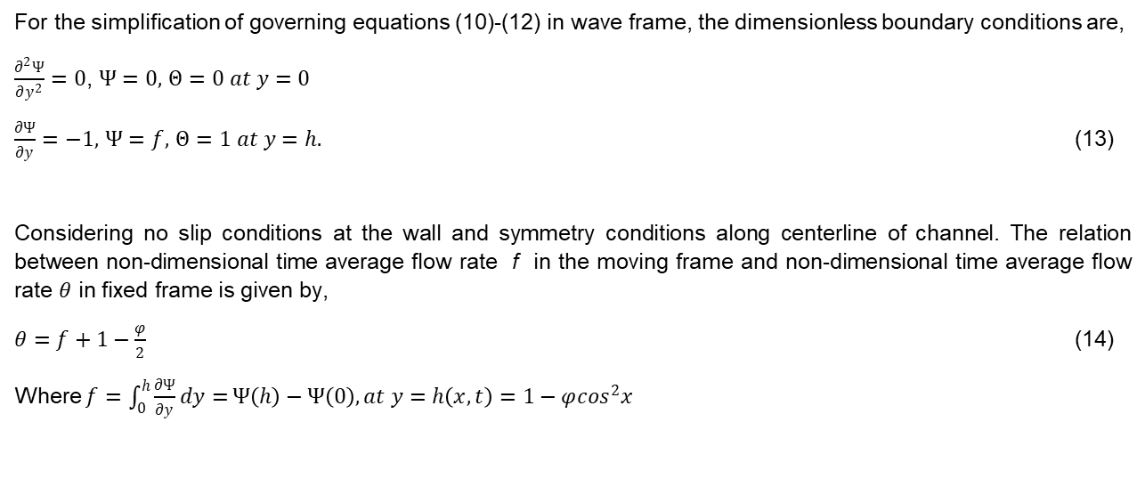
For the simplification of governing equations (10)-(12) in wave frame, the dimensionless boundary conditions are,
$\frac{∂^{2}Ψ}{∂y^{2}}=0$, $Ψ=0,$ $Θ=0 at y=0$
$\frac{∂Ψ}{∂y}=−1,$ $Ψ=f,$ $Θ=1 at y=h.$ (13)
Considering no slip conditions at the wall and symmetry conditions along centerline of channel. The relation between non-dimensional time average flow rate f in the moving frame and non-dimensional time average flow rate $θ$ in fixed frame is given by,
$θ=f+1−\frac{φ}{2}$ (14)
Where $f=\int_{0}^{h}{\frac{∂Ψ}{∂y}dy=}Ψ\left(h\right)−Ψ\left(0\right), at y=h\left(x,t\right)=1−φ\cos^{2}x$

Slide 29
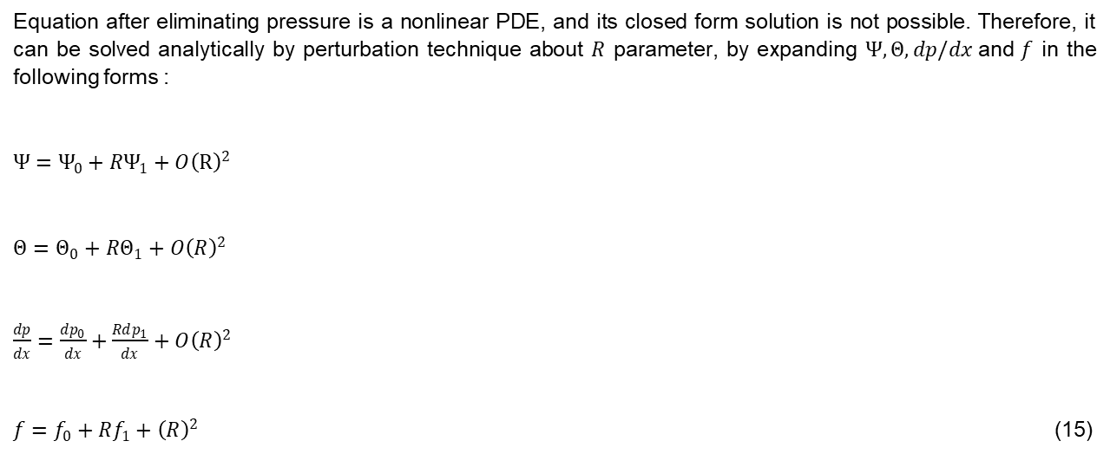
Solution Methodology
Equation after eliminating pressure is a nonlinear PDE, and its closed form solution is not possible. Therefore, it can be solved analytically by perturbation technique about $R$ parameter, by expanding $Ψ,Θ,dp/dx \text{and} f$ in the following forms :
$Ψ=Ψ_{0}+RΨ_{1}+O{\left(R\right)}^{2}$
$Θ=Θ_{0}+RΘ_{1}+O{\left(R\right)}^{2}$
$\frac{dp}{dx}=\frac{dp_{0}}{dx}+\frac{Rdp_{1}}{dx}+O{\left(R\right)}^{2}$
$f=f_{0}+Rf_{1}+{\left(R\right)}^{2}$ (15)

Slide 30
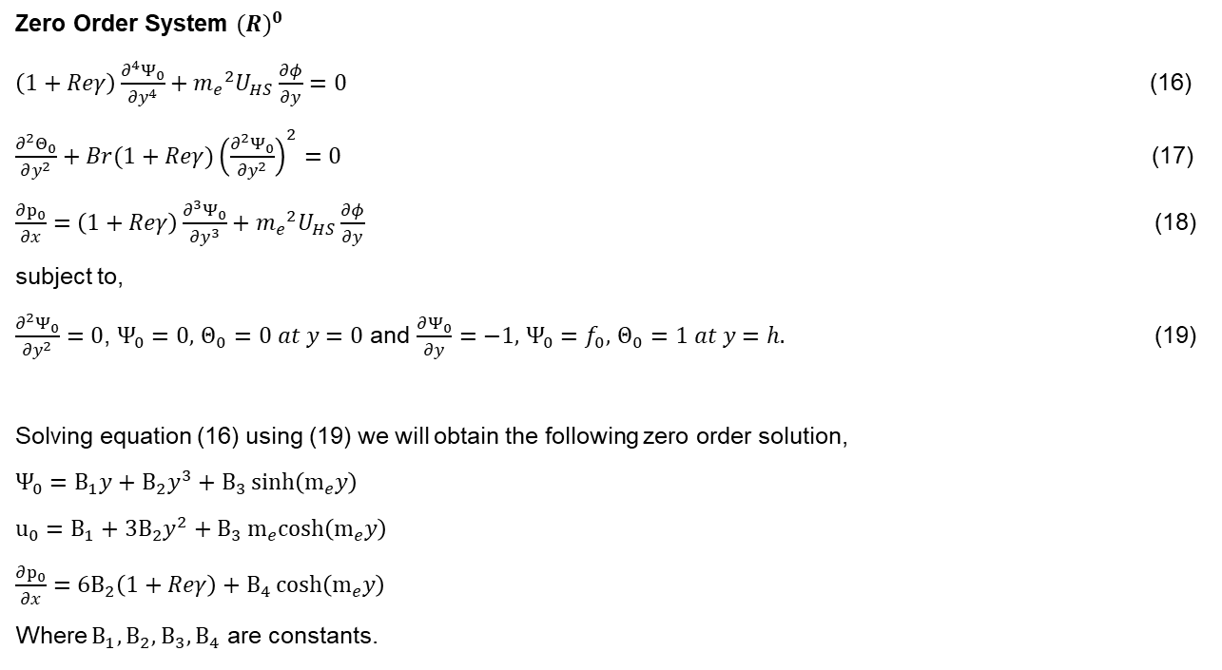
Zero Order System ${(R)}^{0}$
$\left(1+Reγ\right)\frac{∂^{4}Ψ_{0}}{∂y^{4}}+{m_{e}}^{2}U_{HS}\frac{∂φ}{∂y}=0$ (16)
$\frac{∂^{2}Θ_{0}}{∂y^{2}}+Br(1+Reγ){\left(\frac{∂^{2}Ψ_{0}}{∂y^{2}}\right)}^{2}=0$ (17)
$\frac{∂p_{0}}{∂x}=\left(1+Reγ\right)\frac{∂^{3}Ψ_{0}}{∂y^{3}}+{m_{e}}^{2}U_{HS}\frac{∂φ}{∂y}$ (18)
subject to,
$\frac{∂^{2}Ψ_{0}}{∂y^{2}}=0$, $Ψ_{0}=0,$ $Θ_{0}=0 at y=0$ and $\frac{∂Ψ_{0}}{∂y}=−1,$ $Ψ_{0}=f_{0},$ $Θ_{0}=1 at y=h.$ (19)
Solving equation (16) using (19) we will obtain the following zero order solution,
$Ψ_{0}=B_{1}y+B_{2}y^{3}+B_{3}\sinh\left(m_{e}y\right)$
$u_{0}=B_{1}+3B_{2}y^{2}+B_{3}m_{e}cosh\left(m_{e}y\right)$
$\frac{∂p_{0}}{∂x}={6B}_{2}\left(1+Reγ\right)+B_{4}\cosh\left(m_{e}y\right)$
Where $B_{1},B_{2},B_{3},B_{4}$ are constants.

Slide 31
Future Work
We will be deriving first order solutions for the system and obtain approximate analytical solutions.
We will be plotting graphs for velocity profile, temperature distribution and pressure gradient with respect to different parameters to analyze the effects of different parameters on them.

Slide 32
Thank You

